Slide 1
Water Potability
By Lorena Arias and Karen Serrano

Slide 2
01
02
03
04
Topics to Cover
Objective and Data Source
Data Preparation
Models Applied
Evaluation

Slide 3
Objectives and Data Source
The primary objective is to determine whether the water is safe for human consumption.
By building a classification model, the purpose is to accurately classify water samples as either potable (safe for drinking) or non-potable (unsafe for drinking) based on various water quality parameters, such as pH, hardness, turbidity, etc.
Data Source : The data was obtained from Kaggle.

Slide 4
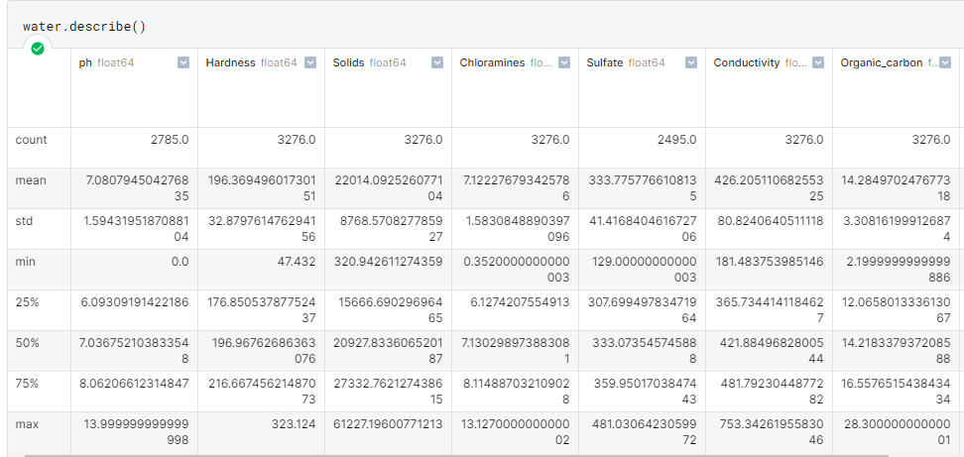
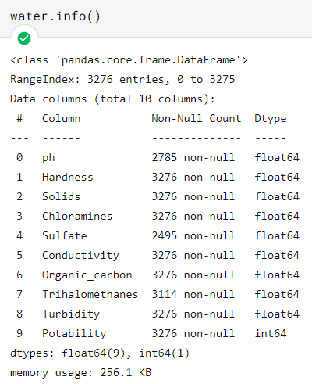
Descriptions of the Data

Slide 5
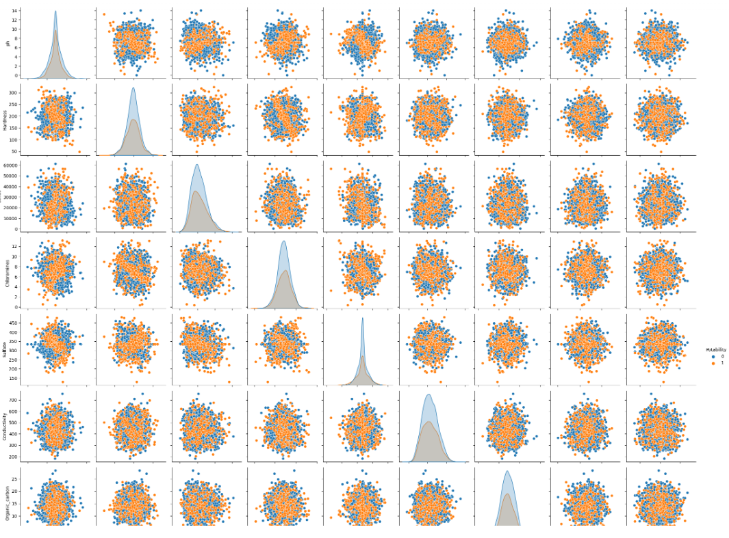

Slide 6
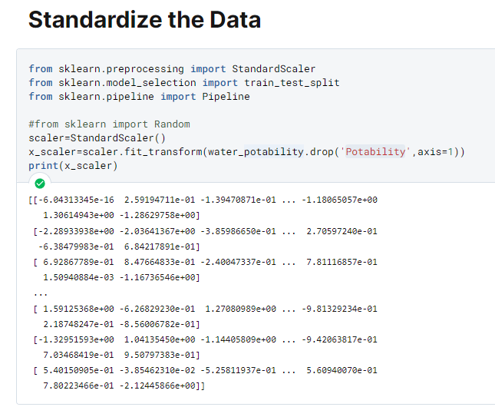
Data Scaling

Slide 7
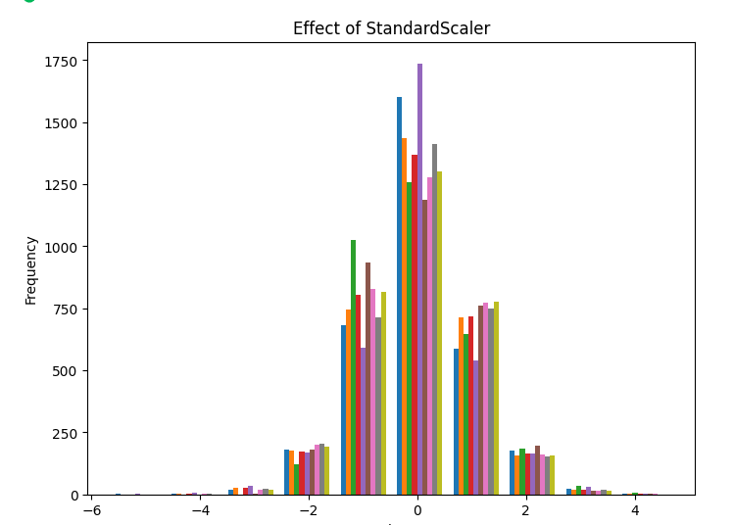
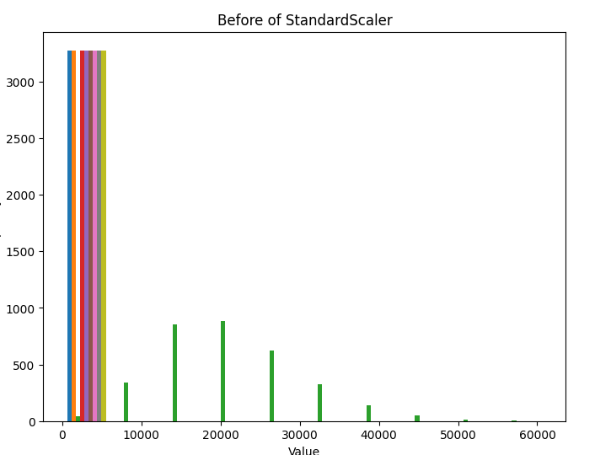
Data Scaling Visualization

Slide 8
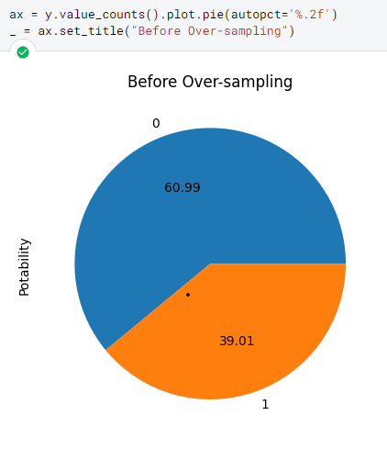
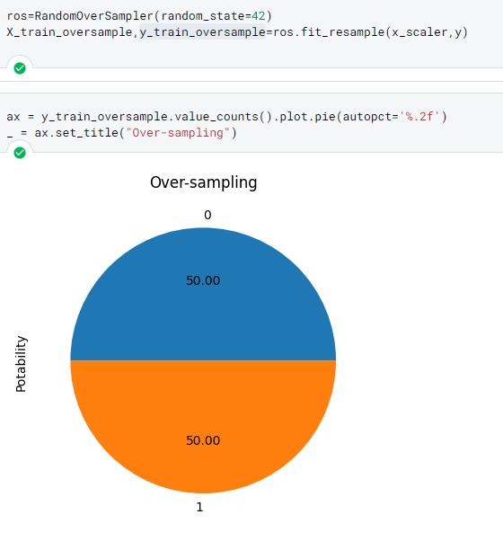
Advanced Techniques for imbalance data

Slide 9
Models in Supervised Learning

Slide 10
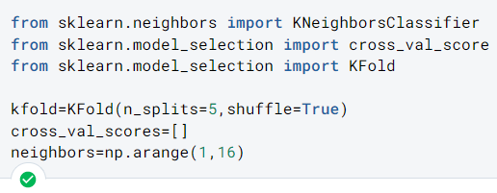
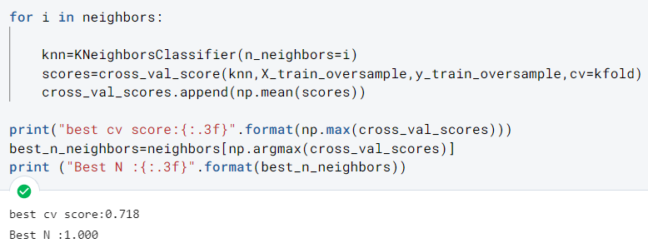
K-Nearest Neighbors
K-Fold Cross Validation estimates the performance of the model.
The best K value, which gives the highest accuracy. This was obtained by indexing the neighbors array with the index of maximum value.

Slide 11
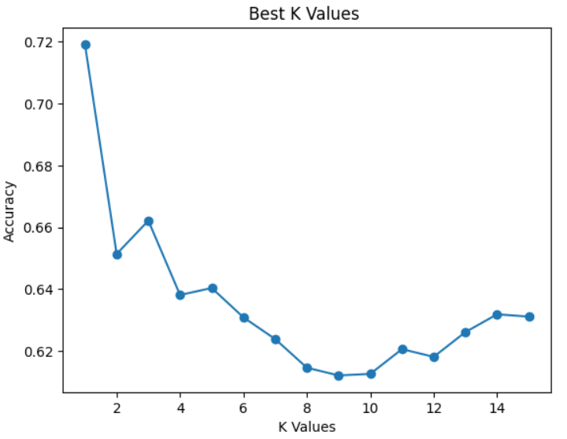
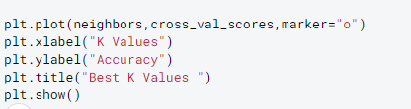
Best K Values

Slide 12
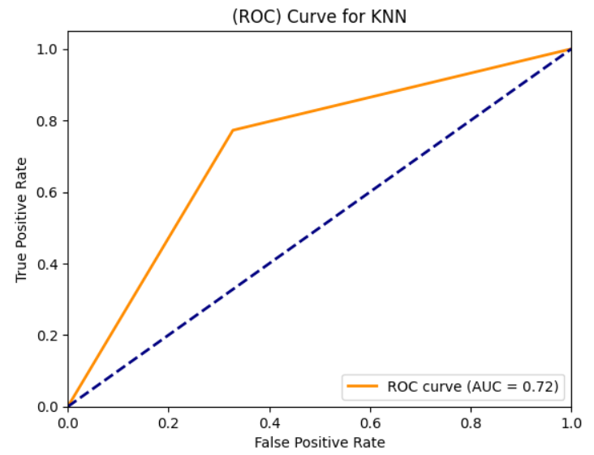
ROC Curve for KNN

Slide 13
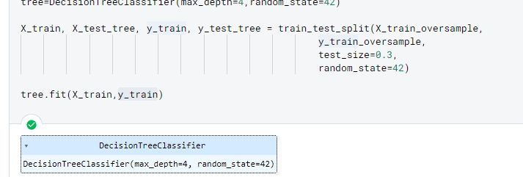
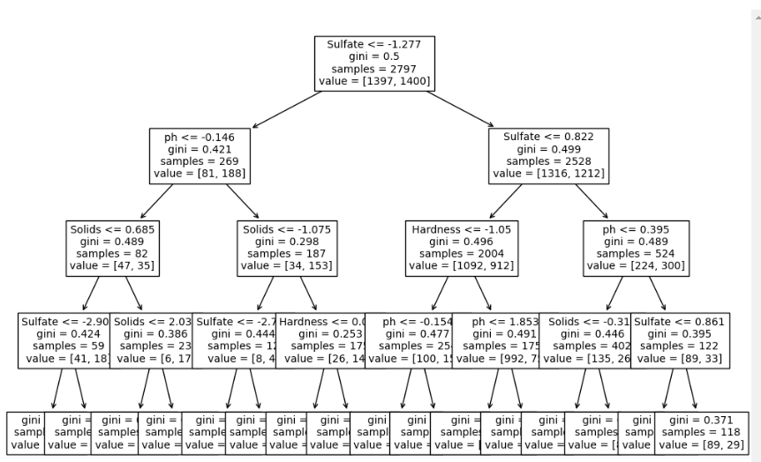
Decision Tree

Slide 14
Evaluation Model

Slide 15
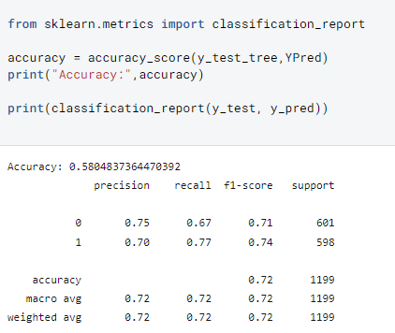
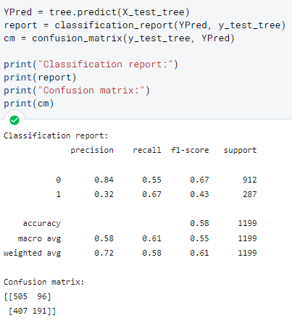
Evaluation Metrics
KNN
Decision Tree

Slide 16
Conclusions
KNN model is able to correctly classify a similar proportion of the samples for each target variable. The precision values for 0 and 1 were similar indicating that it is a good classification. The other metrics such as recall, f1 and support were also similar for this model.
The decision tree has similar Accuracy but appears to have lower precision value for the positive class , indicating that this model can classify some negative cases as positive. Also , values such as F1 which indicate how well the model is able to correctly classify both positive and negative cases is lower than 50%.

